Slide 1
Xplico – Network Forensic Analysis Tool (NFAT)
Name: Basel Alzyoud
Student ID: AC0342
Subject: Digital Forensic by Dr. Nader Salameh

Slide 2
Xplico reconstructs the contents of captures preformed with a packet sniffer (ex. Wireshark)
Packet analyzers do not reconstruct the data carried by the protocols while Xplico does.
Xplico reconstructs the protocol’s application data it is able to recognize the protocols with a technique named Port Independent Protocol Identification (PIPI).
Xplico is open-source software_released_under_GNU GPL v2.
Written in C, PHP, Python, Latest release is 1.2.2 / 2019

Slide 3
Xplico features
Extract and reconstruct all the Web pages and contents (images, files etc.) from raw HTTP protocol data.
Reconstruct the e-mails exchanged from raw data of SMTP, POP, IMAP protocols.
Identifies and reconstructs VoIP, MSN, IRC and FTP as well.
Installed by default in Kali Linux, DEFT, Security Onion etc.

Slide 4
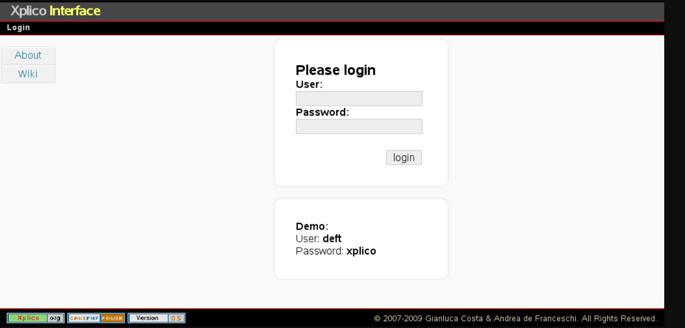

Slide 5
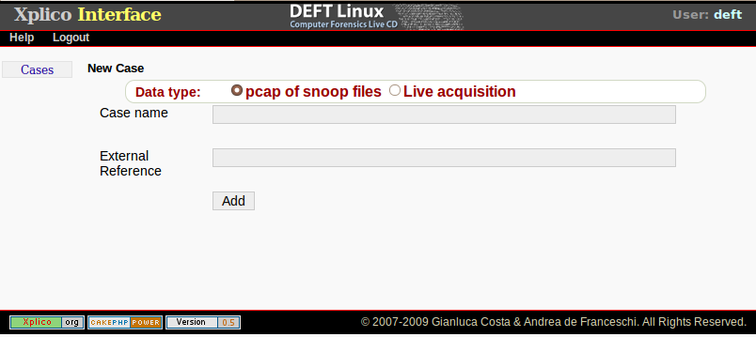
We create a new case so the case coincides with listening point this because the Xplico system try to correlate the data extracted, to:
emulate browser cache
reconstruct P2P files (downloaded in many days)
reconstruct files downloaded

Slide 6
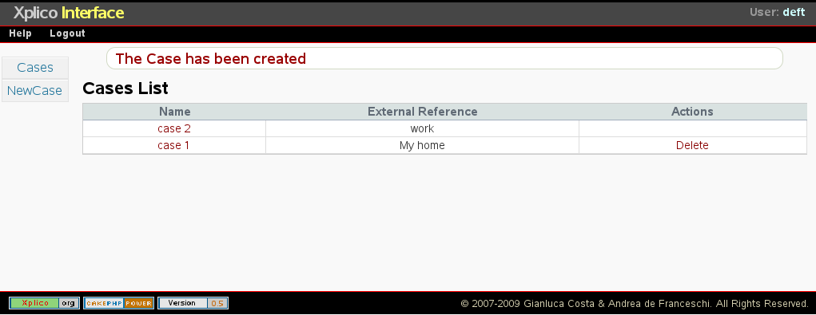

Slide 7
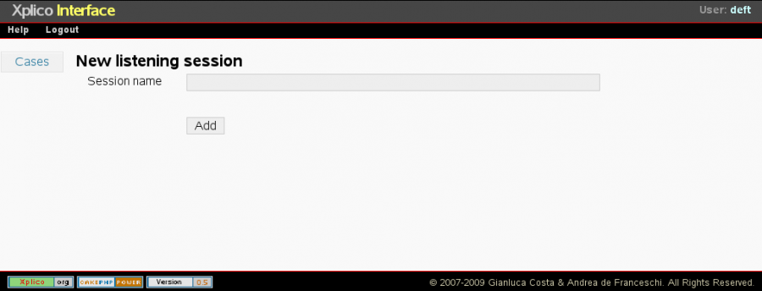
A case is composed of one or more sessions, then selecting a case we enter in sessions page. In Xplico each session contains the data acquired in a specific time interval, the time intervals of each session must be disjoint and each stating time of a session must be greater or equal than the ending time of previous session. To create a new session inside a case we have to click “New sol” button. A session is defined only by a name: session name

Slide 8
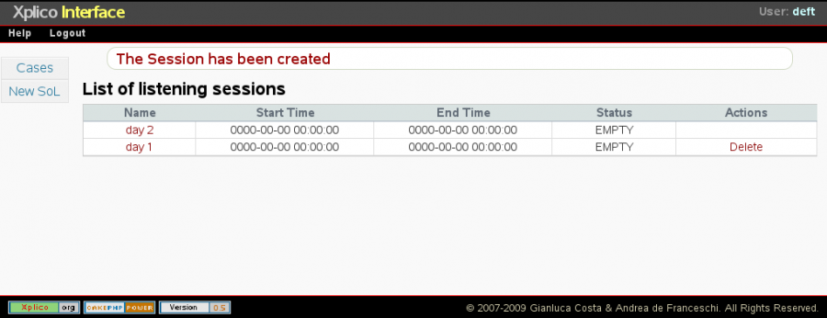

Slide 9
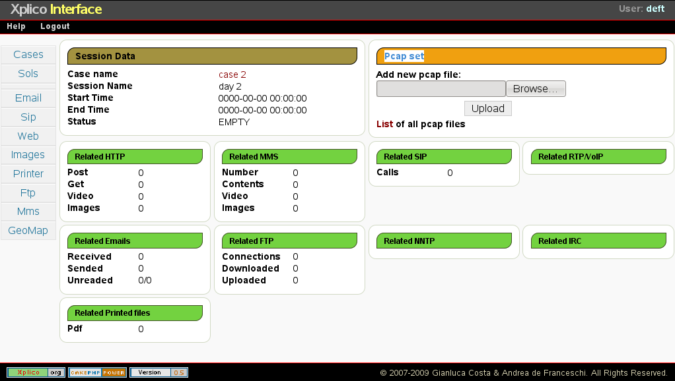

Slide 10
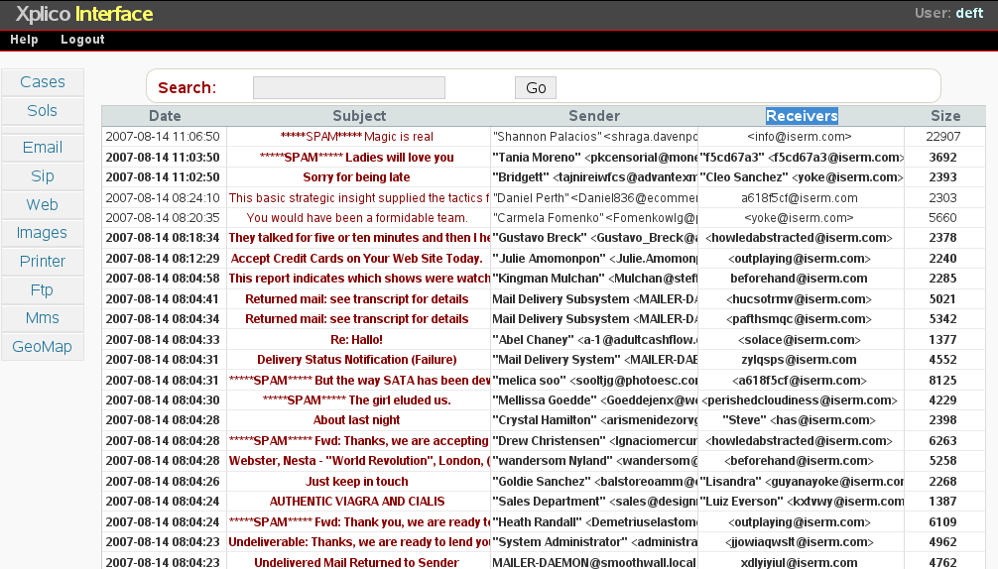

Slide 11
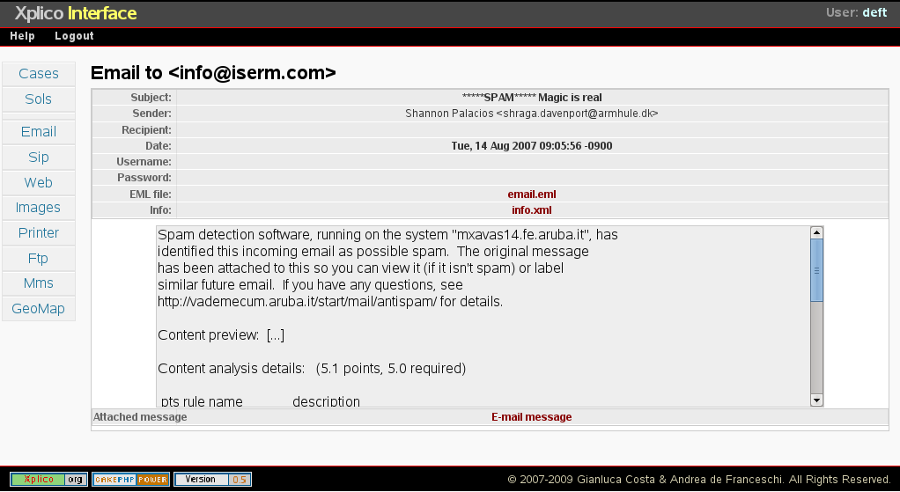

Slide 12
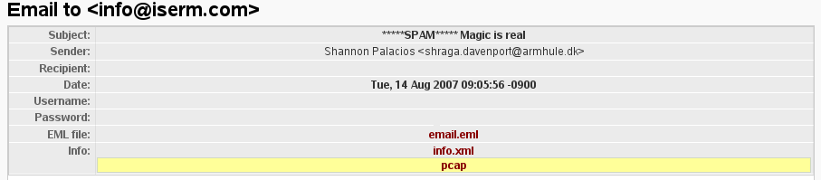

Slide 13
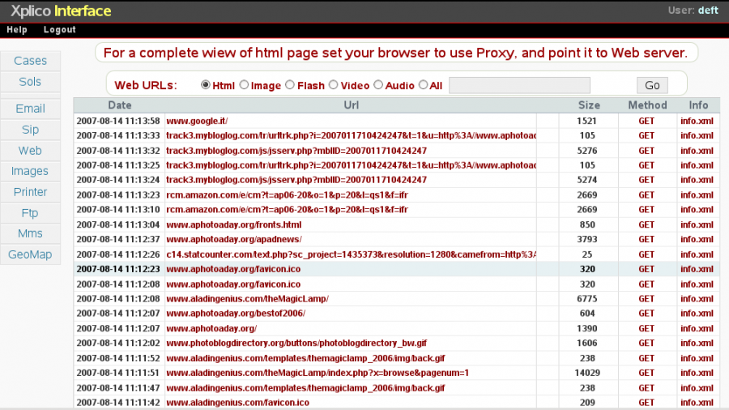
Clicking on a link will open a new page (separated), in which, with Xplico System, will rebuild the full url of that page, contained in pcap decoded. Xplico System simulate the original cache of the browser, of course if the pcap (in all sessions of case) contain the data to simulate the cache. Everything works if and only if the proxy is enabled in Firefox and it is pointing to the server that runs Xplico System.

Slide 14
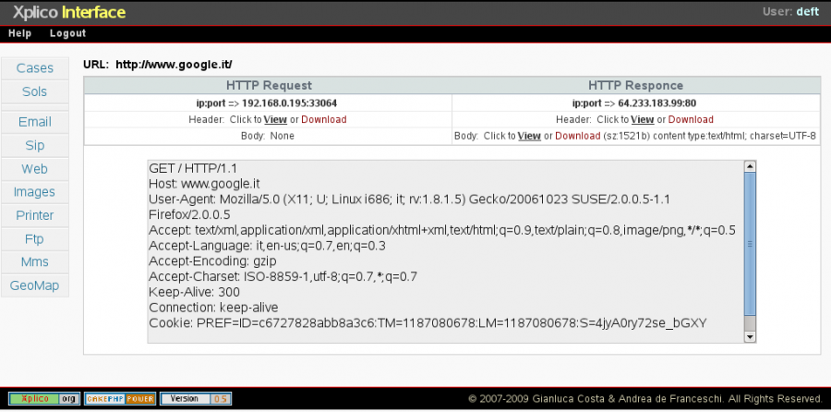
Besides, for each contents we can examine the request header, response header and the body by clicking upon method link. It is possible to achieve the pcap with inside only the flow that transport the content.

Slide 15
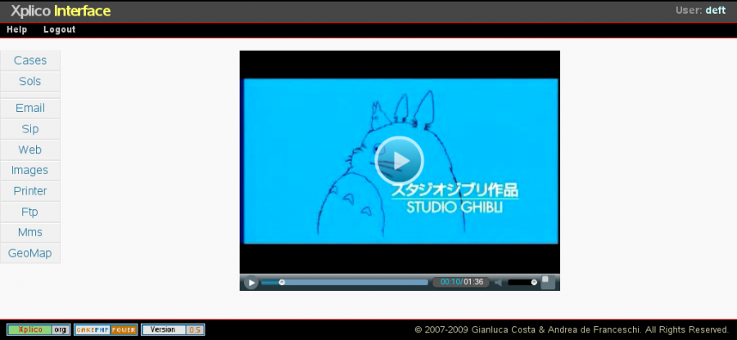

Slide 16
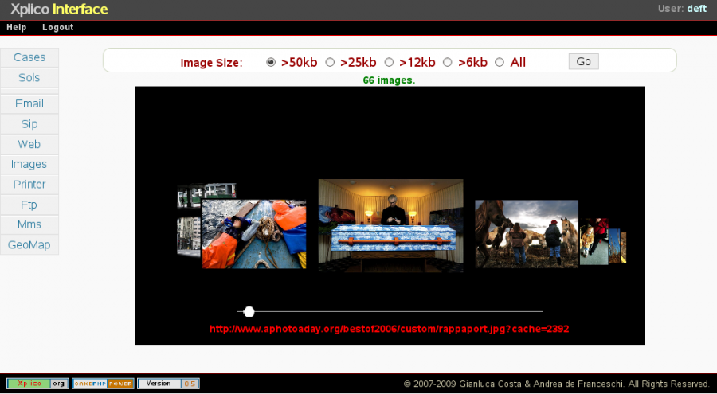

Slide 17
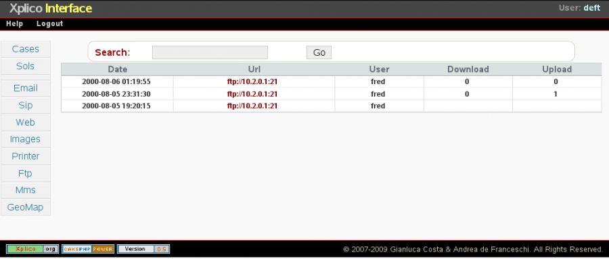
The pages of FTP and TFTP are similar.
In the main page we can see the list of all connections to the ftp/tftp server, with the corresponding number of files downloaded and uploaded..

Slide 18
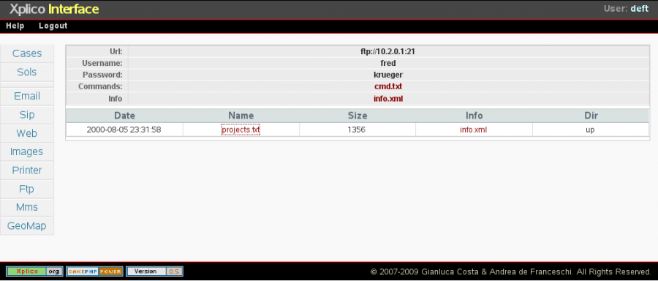
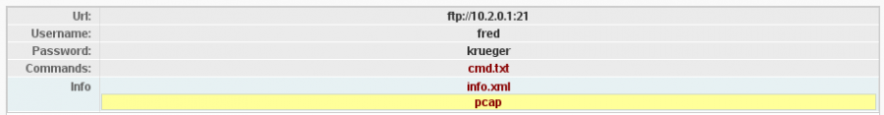
For every server, clicking on the link, we can see the information of server, user name, password, commands, files downloaded and files uploaded.
For each file you can have the corresponding pcap file that contains only the packets to the file.
You can also examine all the commands exchanged with the server.

Slide 19
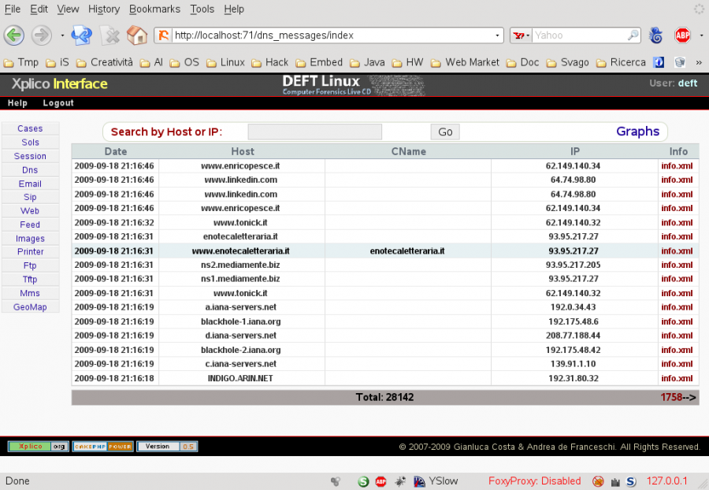

Slide 20
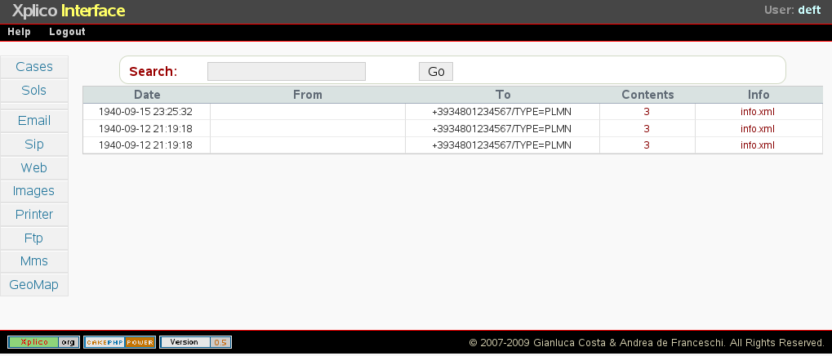
If the MMS messages (Multimedia Messaging Service) are transported by HTTP protocol then Xplico decoder can decompose the MMS message into its content, ie text, video and images. The main page of MMS reports the list of MMS decoded,

Slide 21
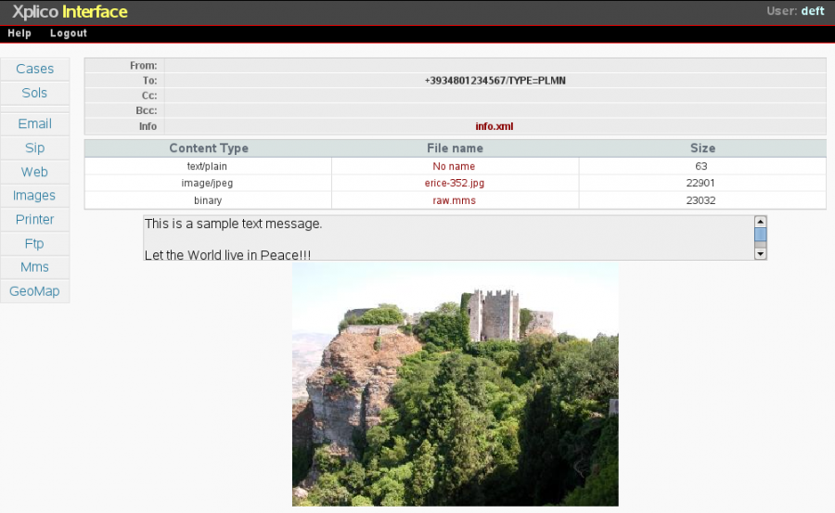
If you have the MMS message in the binary (raw) form, then you can decode it with mmsdec tool.

Slide 22
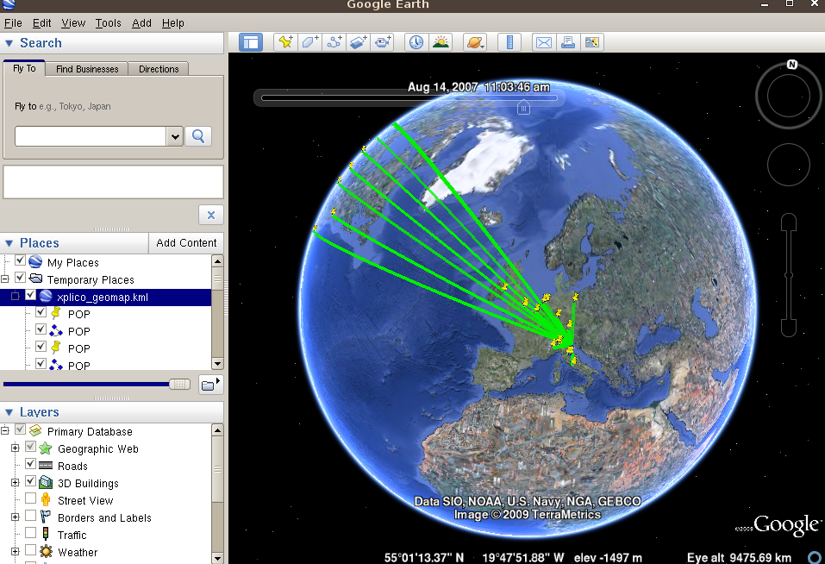
During a session decoding Xplico produces a KML file, this file, used with Google Earth, allows you to have a temporal and geographical map of connections decoded by Xplico

